Slide 1

Accounting and Economics
Faculty of Engineering
Semester VI
By: Danisha De Mel
MBA (USJP), BBA (Finance) sp., CIMA passed finalist, MILT, MCPM
Department of Management and Finance
Faculty of Management, Social Sciences and Humanities
General Sir John Kotelawala Defence University

Slide 2
CVP ANALYSIS

Slide 3
Intended Learning Outcomes
At the end of this session learners should be able to;
Understand the cost behaviours
Explain profit equation
Explain contribution
Calculate BEP
Calculate Margin of Safety
Decision making based on BEP

Slide 4
The Profit Equation
Operating
Profit
Total
Revenue
Total
Costs
=
–
Operating profit equals to total revenue
less total costs.

Slide 5
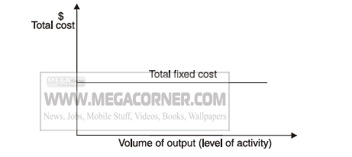
Cost Behavior Patterns
Fixed Cost
Cost which tends to be unaffected by the level of activity
Ex:-
The salary of the Managing Director
The rent of single factory building

Slide 6
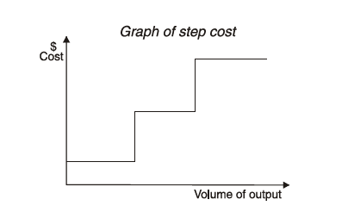
Cost Behavior Patterns
Step Cost
Cost which is fixed in nature but only within certain level of activity
Ex:-
Rent paid to warehouse could be a fixed only up to a particular level of activity. After a certain activity level, more space would be needed for which rent cost will increase.

Slide 7
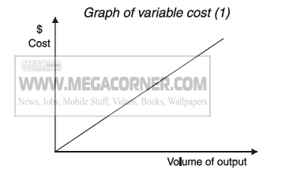
Cost Behavior Patterns
Variable Cost
Cost which tend to vary with the volume of output.
Ex:-
Direct Material cost
Direct Labour cost
Other Direct expenses

Slide 8
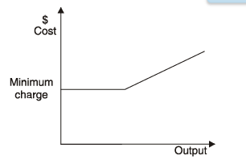
Cost Behavior Patterns
Semi Variable Cost (Semi-Fixed Cost)
Cost which contains both fixed and variable components and so is partly affected by changes in the level of activity.
Ex:-
Factory Electricity Bill;
Fixed cost – Monthly Charge
Variable cost – Charge per unit consumed

Slide 9
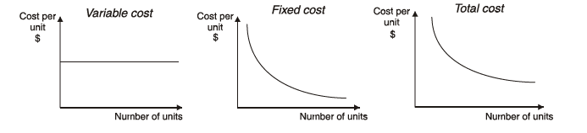
Cost behavior and per unit cost
What happens to the COST PER UNIT when activity level rises?
The variable cost per unit remains constant
The fixed cost per unit falls
The total cost per unit falls

Slide 10
The Profit Equation
Operating
Profit
Total
Revenue
Total
Costs
=
–
= TR – TC

Slide 11
The Profit Equation
Total
Revenue
Average Selling
Price Per Unit
Units of
Output
=
×
TR = P × X

Slide 12
The Profit Equation
Total
Costs
Variable Costs
Per Unit
Units of
Output
Fixed
Costs
=
×
+
TC = (V × X) + F

Slide 13
The Profit Equation
Now, we’ll expand our
original equation for profits!
=
(P × X) - [(V × X) + F]
=
(P – V)X – F

Slide 14
Contribution
Sales = Variable Cost + Fixed Cost + Profit or Loss
Sales – Variable Cost = Fixed Cost + Profit or Loss
Sales – Variable Cost = Contribution
Contribution = Fixed Cost + Profit or Loss

Slide 15
Break-even Point (BEP)
Break even point is the level of sales at which profit is zero. According to this definition, at break even point sales are equal to fixed cost plus variable cost . This concept is further explained by the following equation:
At the BEP:- Total Revenue = Total Cost
Break even sales = fixed cost + variable cost

Slide 16
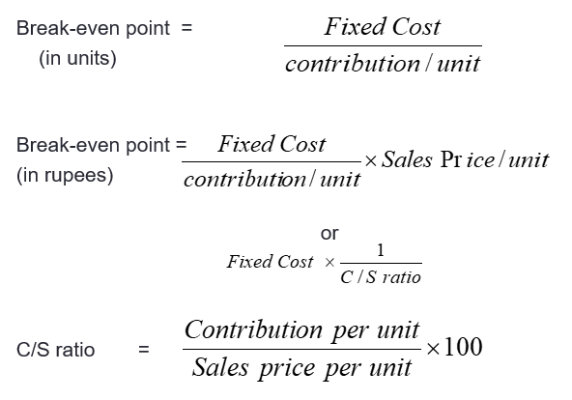
Break-even Point

Slide 17
Target Volume
The formula to find a volume expressed in units for a target profit is . . .
Target
Volume
(units)
Fixed costs + Target profit
Contribution margin per unit
=

Slide 18
Example 1
A company makes a single product with a sales price of Rs. 100 and a marginal cost of Rs 60. Fixed costs are Rs. 600000.
Required;
Number of units to break even
Sales at break-even unit
What number of units will need to be sold to achieve a profit of Rs. 200000 per annum ?
What level of sales will achieve a profit of Rs. 200000 per annum?
Because of increasing costs the marginal cost is expected to rise to Rs. 65 per unit and fixed costs to Rs. 700000 p.a. If the selling price can not be increased what will be the number of units required to maintain a profit of Rs. 200000 p.a ?

Slide 19
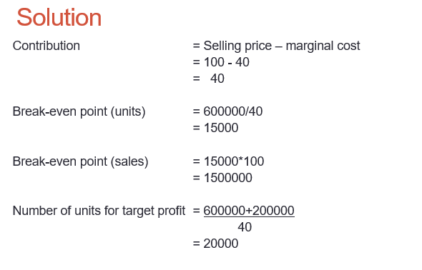
60

Slide 20
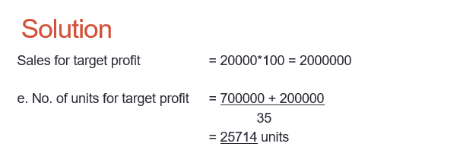

Slide 21
Margin of Safety
Excess of projected (or actual) sales over the break-even volume.
Margin of Safety =
Sales - Break-even
volume sales volume

Slide 22
Practice Question
A manufacturer incurred the following costs in a period for his sole product:
Labour (25% Variable) $ 8000
Material (100% variable) $ 12000
Selling costs (10% variable) $ 2000
Other costs (fixed) $ 7000
Total Costs $ 29000
A normal period’s sales are 500 units at $ 70 each, but up to 650 units could be made in a period. Various alternatives are being considered:
  Reduce the price to $ 63 each and sell all that could be made
  Increase the price to $ 80 each at which price sales would be 400 units
  Keep the present plan
  What is the most profitable plan ?
  What are the C/s ratios ?
  What is the break-even-point for each alternative ?

Slide 23
Answer
Item | VC | FC
Labour (25%) | 2000 | 6000
Material | 12000 | -
Selling Cost | 200 | 1800
other |  | 7000
Total | 14200 | 14800
VC per unit = 14200/500 =28.4

Slide 24
Sales Units | 650 | 400 | 500
Sales Price | 63 | 80 | 70
Sales | 40950 | 32000 | 35000
VC(28.4x units) | 18460 | 11360 | 14200
FC | 14800 | 14800 | 14800
Profit | 7690 | 5840 | 6000
Contribution | 22490 | 20640 | 20800
C/S | 0.5492 | 0.645 | 0.5942
BEP (FC/c/s) | 26948 | 22945 | 24907
BEP Units | 427 Units | 287 units | 356 Units

